Slide 1
RPG Escape by FPGA Game Studio
Zahra Azad
James Fallacara
Kaitlin Walsh
Jiahao Zhao

Slide 2
Project Goals and Motivation
Video game development is an interesting topic in terms of programming and problem solving. Many different modules need to work in parallel to deliver an exciting gaming experience.
Creating a video game on the FPGA has its own unique challenges including memory restrictions, FSM coordination, and implementing logic that is usually heavily based on software concepts like loops into something that would work with hardware
Our project could be used as the base for a video game emulator, especially for earlier games like Pac-Man
Our main project goal was to develop a video game that could be implemented on an FPGA. We decided to implement an RPG that included exploring a maze environment, battling enemies, and ultimately escaping from the maze.
Notes:
James

Slide 3
Project Assignments
James: Game Engine and Game Sprites
Zahra: Game Engine and BRAM
Jiahao: VGA Controller
Kaitlin: Collision Detection and maze generation/display

Slide 4
High-Level Functionality Overview
Our game works by implementing a FSM to determine which state the game is in, and changing the VGA output accordingly.
State 0 is the Start screen, which just displays the game title and waits for user input to begin the game.
State 1 is the Maze and Player Movement state, where the player can move around our maze and interact with enemies. Colliding with an enemy changes the state to a battle state.
State 2 is the Battle State. In this state, players battle enemies until on character’s health drops to 0. At this point, a battleWin signal or a battleLose signal is sent to the FSM, which determines if the game will return to State 1 or if it will proceed to state 3. In addition, there is a gameWin signal that is sent to the top FSM when the player defeats five enemies. This will also change the game state to State 3, but with a different result.
State 3 is where we display if the player won or lost the game. A Win/Lose message is displayed on the screen, and the player has the option to reset the game, which brings them back to State 0.
Notes:
Kaitlin

Slide 5
High-Level Specification Overview
A Start Screen is displayed when the user first loads the game onto the FPGA.
Once the game has started, a map screen containing a maze and five enemies is displayed.
Our character needs to be able to traverse this maze. This includes moving the character on the screen and ensuring he does not walk through the walls of the maze.
Our character interacts with enemies by bumping into them. This starts a battle sequence between the player and the enemy character.
A player defeats an enemy if they manage to get the enemy’s health to 0. A player loses the game if their own health falls to 0.
Probability and damage tweaking improves replayability and player experience
Notes:
James

Slide 6


Detailed Project Functionality - VGA Controller
We included more sprites and developed a collision detection algorithm to build a more polished game. We can show a sprite by giving the position of its top left pixel and access the other pixels by setting offsets based on the given pixel. For example, the sprite on the right has a size of 32x64 pixels. If we want to show the right player on the first row, the horizontal offset will be 16 (the width of a sprite), and the vertical offset will be from 0. Then we read the square area defined by pixel (16, 0) and pixel (63, 31).
By setting offset to read different pictures from the block memory, we also implemented animation for the player’s movements and shaking flowers.
Collision detection is what determines if a player can move in a certain direction. To implement this, we keep checking one pixel ahead to see if there is a obstacle, such as a wall. If they have encountered an enemy, an enemyCollision signal is then sent to the game engine which decides if the game should enter battle state or not. The outcome of this state is that the player wins or the enemy wins. To determine whether the player encounters a wall,
Notes:
Jiahao

Slide 7
Detailed Project Functionality - Game Engine
Collision detect from VGA controller
Battle begins when player collides with enemy
Battle_start sets HP and PP
Person’s turn to strike
Choose a move by key press
Each subsequent enemy has more HP
Game Over if enemy wins
Win counter increases per enemy defeated
Attacks have accuracy
Attacks vary by 20% of average value
$random%number
Notes:
Kaitlin

Slide 8
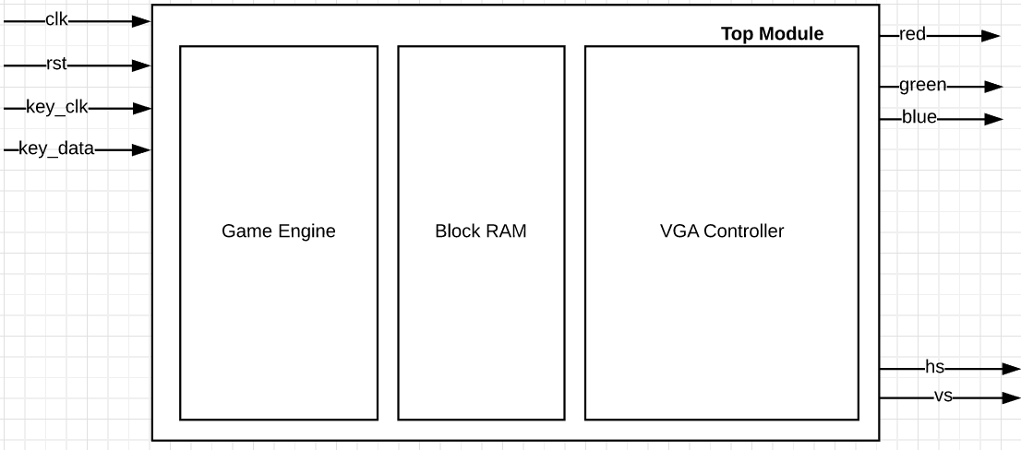
Block Diagrams - Level 0
Detailed Block Diagrams – provide the real block diagrams for your design. You can weave these in with #5.
Notes:
James

Slide 9
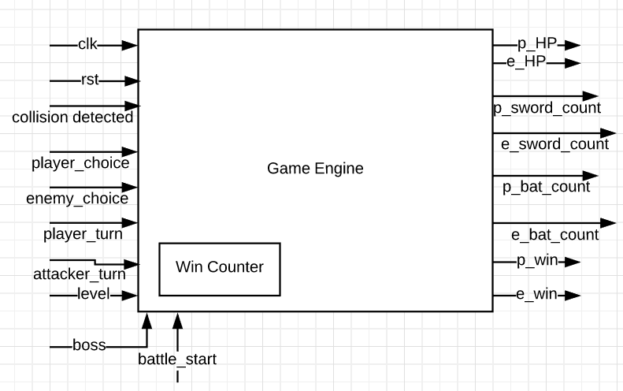
Block Diagrams - Level 1
Notes:
James

Slide 10
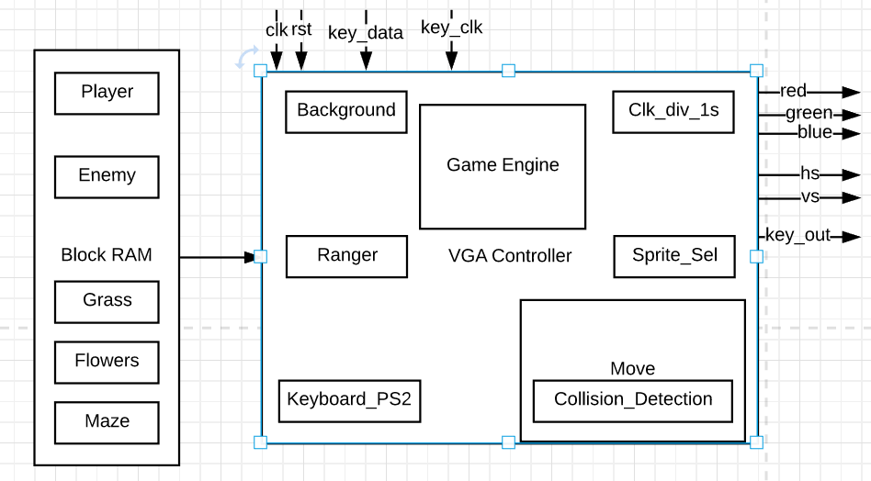
Block Diagrams - Level 2
Notes:
James

Slide 11
Verilog Example - Collision Detection (Enemies)
A large part of our project was detecting collisions between the player sprite and objects in the game. These included the walls of our maze and the enemies on the map.
Player/Enemy collision detection was implemented by comparing the hitbox of the player sprite with the hitbox of an enemy sprite. Each sprite occupied a space of 16 x 16 pixels on our screen. Our collision detection module first determined if there was a collision on the horizontal axis, and then determined if that collision was above, below, or in line with the vertical position of the player.
This module needed to be instantiated for each enemy we placed on the map because of the way we stored the enemy positions on the map.
Notes:
From Kaitlin: I can talk about the whole collision detection section

Slide 12
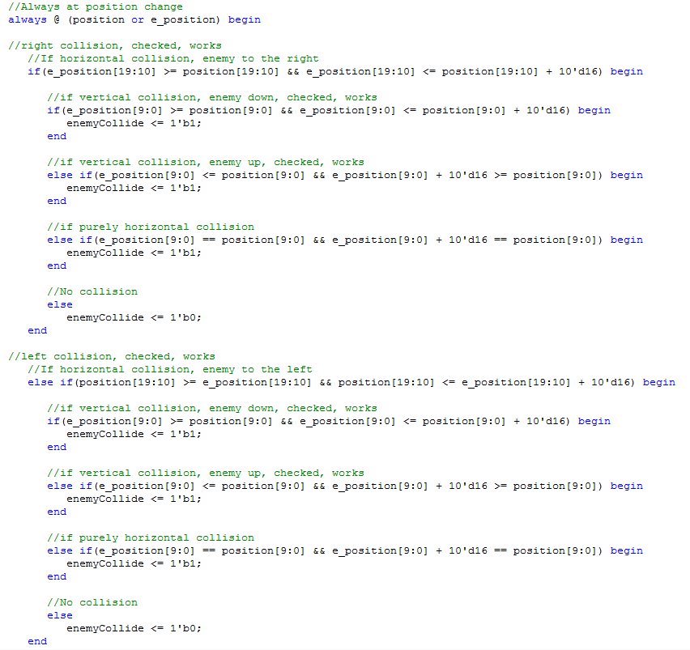

Slide 13
Verilog Example - Collision Detection (Walls)
Our game’s maze was generated using a 20x15 matrix of 1s and 0s, where 1s represented a wall, and 0s represented an area the player could walk on.
Collision detection between the player and the maze walls was implemented directly in our player movement module.
To detect collisions between the player and the maze wall, we determined which “block” of the maze the player would be in based on their current location and their directional input. If they were going to enter a wall block, then player movement was halted; otherwise, they could continue walking.

Slide 14
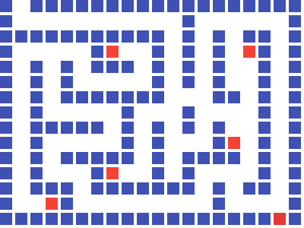

Slide 15
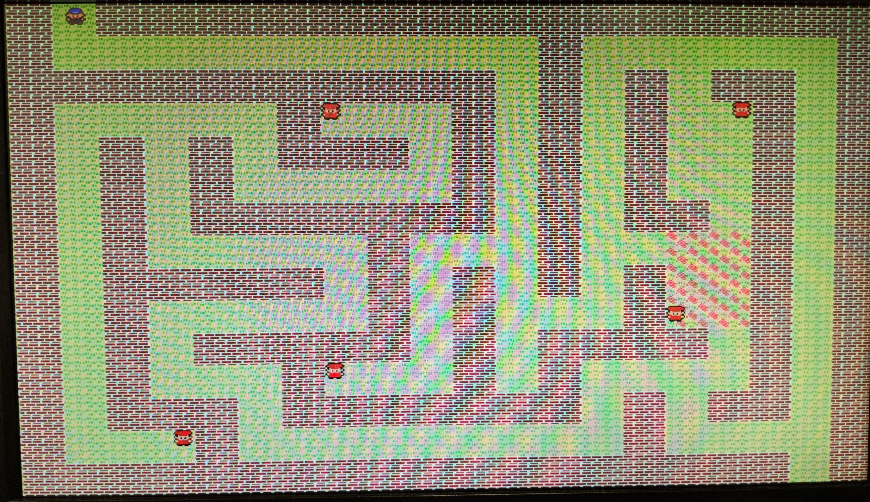

Slide 16
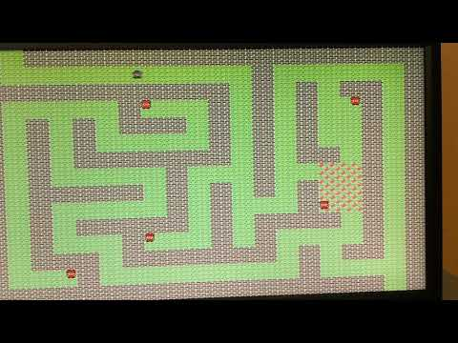

Slide 17
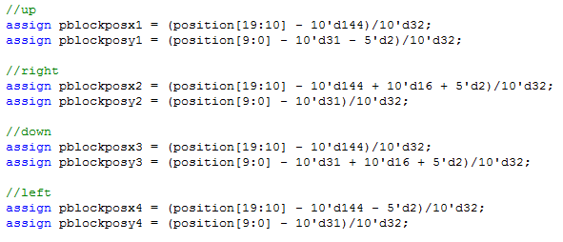


Slide 18
Project Successes
We can load sprites from memory and get them to move around on the screen based on user input from the keyboard.
We can generate a maze in the VGA given a 20x15 maze matrix.
  Maze collision detection is dependant on this matrix as well, which means a different maze layout can be implemented with ease.
We can switch between defined game states at the appropriate times
$random%number conversion when greater than desired range

Slide 19
Current Issues
Displaying the battle screen is the issue we are currently having. We know that our FSM updates the game State accordingly to enter the Battle State on an enemy collision, but we cannot currently show the process of the battle (health points, number of remaining attack types etc.).
We do know that the game engine and battle module work in simulation. Displaying their results is the problem, and will be fixed within the next week.
One other small fix includes implementing a level counter according to the number of enemies defeated.

Slide 20
Project Failures
Random maze generation did not work well in Verilog due to the nature of how it was made in C (while loops, random number generators, etc).
  Alternative: Use C code to randomly generate five mazes and hardcode these into the game module, randomly choose one to load on game start
The maze could also not be as complex as we wanted due to the limitations of the FPGA (whole project crashes when trying to implement a 40x30 maze, needed to downsize to 20x15).
No music implemented
Limitations with the FPGA
  we couldn’t have a separate screen with different sprites the battle mode.
Notes:
Kaitlin

